Slide 1
Communication
PDR Slides

Slide 2
Communication – Requirements
Industrial Grade Radio
Withstand the environment
Reliability and high efficiency
Data Storage and Transmission
Store and transfer data packets when link is available
Desired Orbit for Data Transfer
Need unit to fly near data stations for downlink

Slide 3
Communication - Solutions

Slide 4
Working Assumptions
Assume one event per orbit
Assume communication available to 3 base stations across the United States (Honolulu, Boulder, Fairbanks, maybe Crookston)
Assume circular LEO
Assume each data set on the order of 10 MiB

Slide 5
Questions/Solutions
How much power is required for the broadcast signal?
Link budget
How much time will be available during each orbit for communication?
Link budget
Orbital parameters
Is it possible to transmit all data in the time allotted?
Link budget

Slide 6

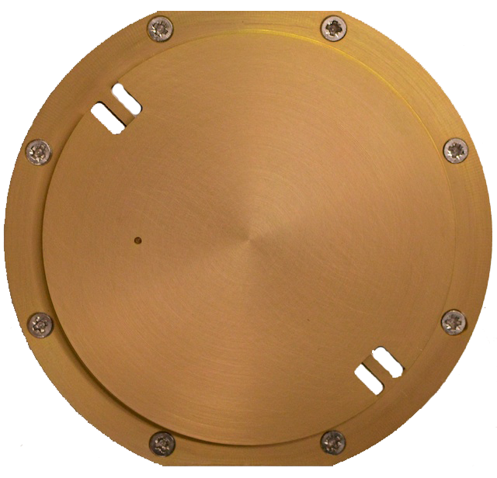
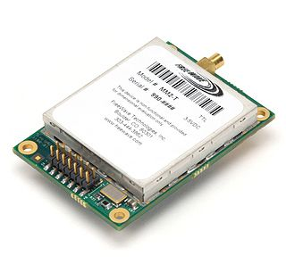


Communication – Scenario 1
Power
-Wattage
-Battery
GPS
-Attitude
-Position
-Time
Gamma Ray Detector
Antenna
Radio
Flight Computer
-Assemble packet
Used if data packets are large and connecting to ground stations is difficult

Slide 7
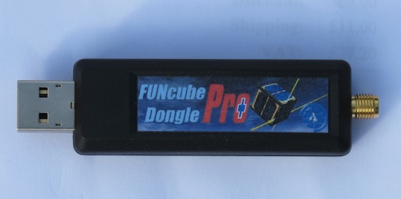
Communication – Scenario 2
Power
-Wattage
-Battery
GPS
-Attitude
-Position
-Time
Gamma Ray Detector
Antenna
FunCube
Flight Computer
-Assemble packet
Cheaper approach if data packets are small enough

